Slide 1





Edit with
×

Slide 2
Problem Statement
Predicting house prices accurately is critical in real estate analytics, helping sellers set reasonable expectations, buyers make informed decisions, and developers assess market value. Housing prices are influenced by complex interactions of structural characteristics, quality indicators, amenities, and location variables.
Technical Challenges Project Workflow
High-dimensional feature space (79 variables)
Mixed data types (numeric, nominal, ordinal)
Strong correlation and multicollinearity among features
Structural and non-structural missing values
Skewed numeric distributions and strong outliers
Exploratory Data Analysis (EDA)
Missing value treatment and outlier handling
Domain-driven feature engineering
Model development and cross- validation
Hyperparameter tuning via GridSearchCV
SHAP explainability and Streamlit deployment

Slide 3


Dataset Overview
1,460
Training Properties
79
Feature Variables
Kaggle Competition
House Prices - Advanced Regression Techniques
•
•
Numeric Features: Living area, lot size, garage capacity, year built
Ordinal Features: Quality ratings, condition scores, basement finish levels
•
•
Categorical Features: Neighborhood, house style, exterior materials
Target Variable: SalePrice (heavily right-skewed, requires log transformation)

Slide 4



Exploratory Data Analysis
Distribution Analysis
Right-Skewed Distributions: Many size-related features (LotArea, GrLivArea, TotalBsmtSF) contain long right tails because most homes are moderately sized while few properties are extremely large.
SalePrice: Exhibited significant right skewness (skewness = 1.88), requiring log transformation to normalize the distribution for linear models and improve training stability.
PoolQC
MiscFeature
Alley
Fence
OverallQual
GrLivArea
GarageCars
TotalBsmtSF

Slide 5
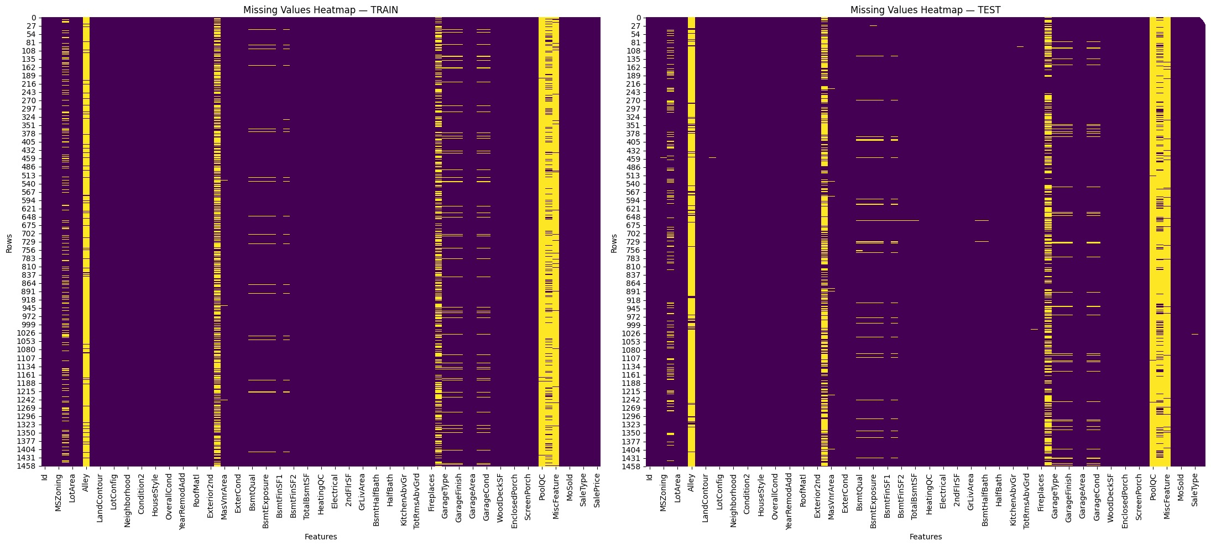
Missing Value Strategy
Structural Absence
Features like BsmtQual, GarageType, PoolQC filled with "None" when component doesn't exist (verified by checking related numeric features = 0)
Heatmap reveals concentrated missingness in optional features (pools, garages, basements)
Neighborhood Median
LotFrontage imputed using median values from same neighborhood to preserve geographic patterns
Mode Imputation
Categorical features like Electrical, MSZoning filled with most frequent value for minor data entry gaps

Slide 6



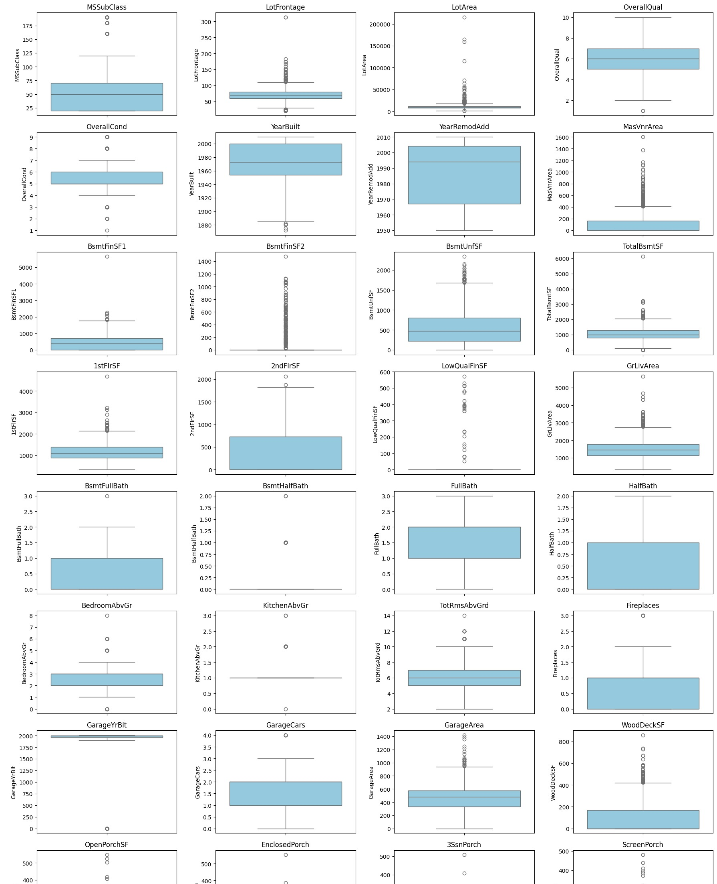
Outlier Handling Strategy
Winsorization
Capped zero-inflated features at 99th percentile to preserve ordering while controlling extremes
Applied standard IQR rule (Q1 - 1.5×IQR, Q3 + 1.5×IQR) for
features with obvious extreme tails
Removed homes with very large living area (GrLivArea > 4500) but unusually low sale prices, likely data entry errors

Slide 7
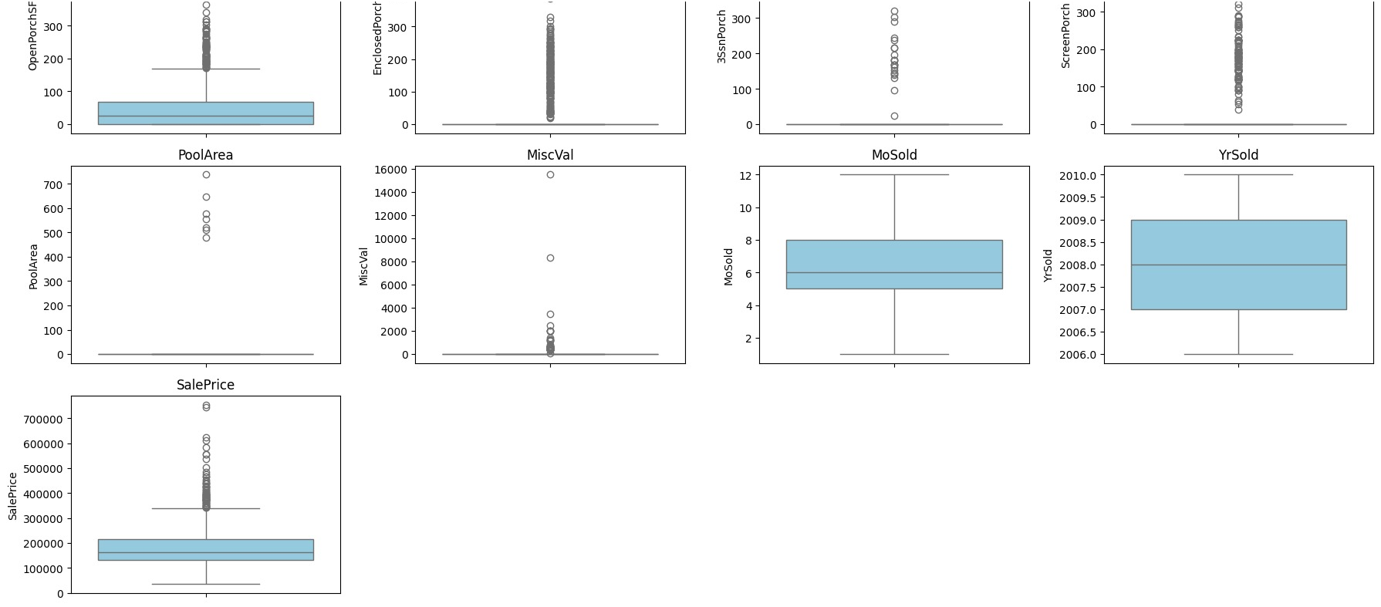
Outlier Distribution Analysis

Slide 8
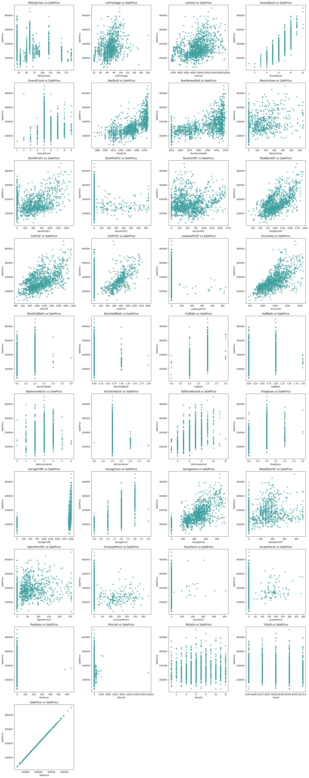
Bivariate Analysis: Features vs SalePrice
Strong Linear Relationships
GrLivArea, TotalBsmtSF, GarageCars, OverallQual show clear upward linear trends with SalePrice
Moderate Relationships
YearBuilt, YearRemodAdd, FullBath, Fireplaces have weaker but meaningful positive trends
Weak Relationships
PoolArea, MiscVal, 3SsnPorch show little relationship - rare, zero-heavy features

Slide 9
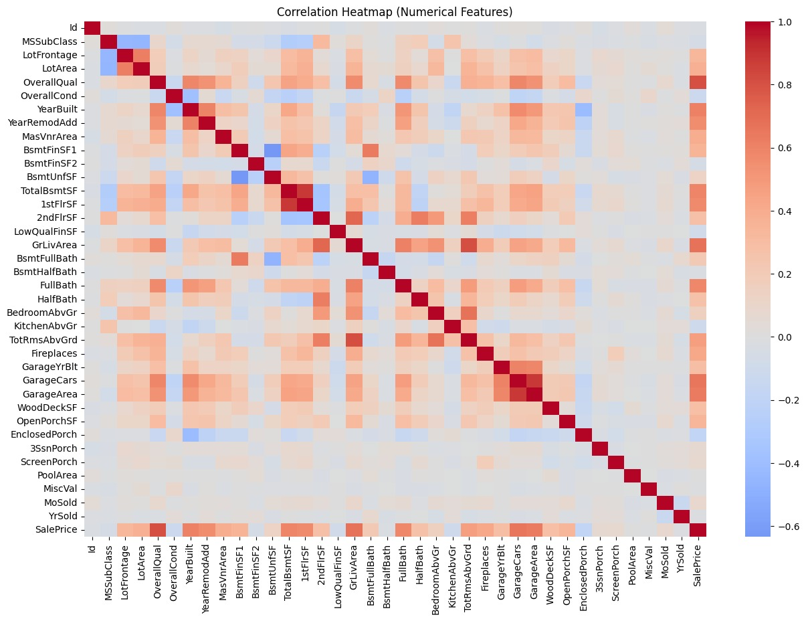
Correlation Matrix & Multicollinearity
Strong Positive Correlations with SalePrice
OverallQual – Strongest correlation with price
GrLivArea – Larger living area = higher value
GarageCars/GarageArea – Garage capacity impact
TotalBsmtSF – Basement contribution to value
Multicollinearity Patterns Detected
GarageCars ↔ GarageArea
GrLivArea ↔ 1stFlrSF
TotalBsmtSF ↔ 1stFlrSF
YearBuilt ↔ YearRemodAdd
→ Feature engineering needed to capture combined signals

Slide 10
Domain-Driven Feature Engineering
Created 7 engineered features to capture complex property characteristics
TotalSF
= 1stFlrSF + 2ndFlrSF + TotalBsmtSF
Complete living area aggregation
OverallQualArea
= OverallQual × GrLivArea
Quality-size interaction term
Total_Bathrooms
= FullBath + 0.5×HalfBath + BsmtFullBath + 0.5×BsmtHalfBath
Standardized bathroom count
QualityScore
= OverallQual + OverallCond + KitchenQual
Composite quality metric
HouseAge & RemodAge
YrSold - YearBuilt, YrSold - YearRemodAdd
Captures aging and renovation recency
TotalPorch
= OpenPorchSF + EnclosedPorch + 3SsnPorch + ScreenPorch
Total outdoor/porch area

Slide 11



Categorical Encoding Strategy
Train-Test Split
For features with natural ordering:
For nominal categories:
80/20 split for validation:
→ ExterQual: Ex(5), Gd(4), TA(3),
Fa(2), Po(1)
→ BsmtQual: Excellent to None (5-0)
→ GarageFinish: Fin, RFn, Unf, None
→ Neighborhood:
25 unique areas
→ HouseStyle: 8 architectural types
→ MSZoning: 5 zoning classifications
Train/Test alignment automatically handled
→ 80% training set for model fitting
→ 20% validation set for evaluation
→ 5-fold cross- validation for robust metrics

Slide 12

Model Development & Comparison
5-Fold Cross-Validation Performance Comparison
Linear Regression
Baseline linear model
Lasso Regression
L1 regularization for sparsity
0.911
0.911
Ridge Regression
L2 regularization for multicollinearity
Best balance of accuracy, stability, and interpretability
0.911
SELECTED MODEL
ElasticNet 0.911
Random Forest
0.900
Gradient Boosting
0.911
XGBoost
Highest R² but more complex
0.917

Slide 13


Why Ridge Regression?
Although XGBoost achieved the highest R², Ridge Regression was selected as the final model
✓
Handles multicollinearity: L2 regularization effectively manages highly correlated features
Cross-Validation R²
0.911
Performance Gap vs XGBoost
~0.6%
Minimal accuracy trade-off for significantly better stability and interpretability
✓
Stable performance: Consistent results across folds with minimal variance
✓
Interpretable: Linear coefficients provide clear feature importance
✓
Efficient: Fast training and prediction, ideal for deployment

Slide 14
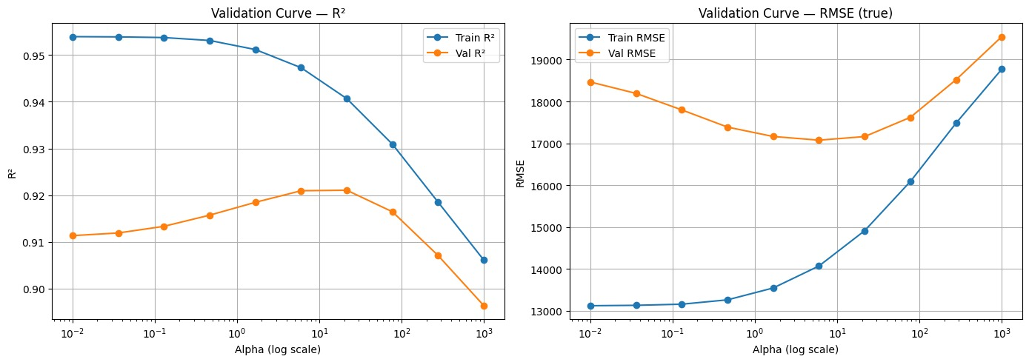

Ridge Hyperparameter Optimization
GridSearchCV Setup
Systematic search over regularization parameter:
Parameter Grid: alpha = [0.1, 1, 10, 50, 100]
Cross-Validation: 5-fold CV
Scoring Metric: R² (coefficient of determination)
Goal: Find optimal regularization strength
Validation Curve Insights
Low alpha: Overfitting (high train, lower validation)
α ≈ 10: Optimal balance (best validation R²)
High alpha: Underfitting (both metrics drop)
Optimal Results
Best Alpha
10
Best CV R²
0.9215
Validation R²
0.9053

Slide 15

Model Diagnostics: Learning Curve Analysis
Convergence Behavior
Training and validation curves gradually converge, indicating a healthy bias-variance balance. The model learns meaningful patterns as more data is added.
Key Observations
Validation error decreases
with more training data
No large gap between train and validation scores
No major overfitting
detected
Model generalizes well to unseen data
Learning Curve Conclusion
Ridge Regression benefits from additional training data and maintains stable, consistent performance across different data subsets, confirming model robustness.

Slide 16

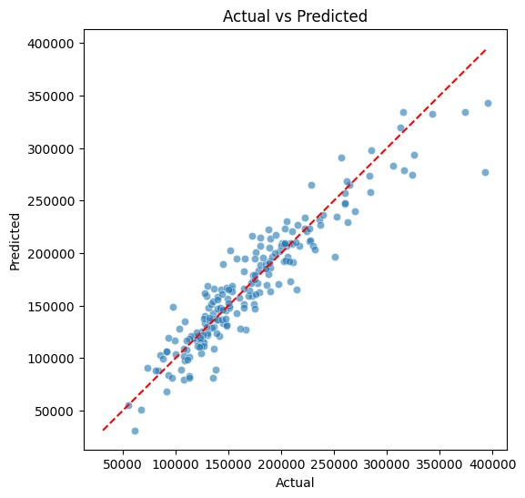
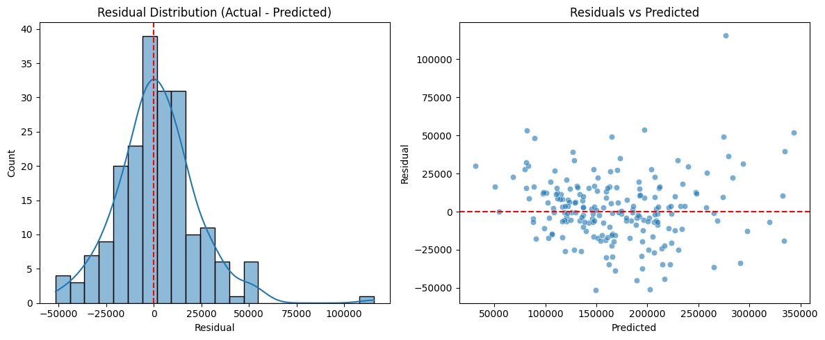
Error Analysis & Model Performance
Performance Metrics
MAE
$15,628
R²
0.8798
RMSE
$21,348
MAPE
9.83%
Model explains ~88% of variance with average prediction error under 10%
Most points lie close to diagonal - predictions align well with actual prices
Residual Distribution
Residuals are centered around zero with approximately normal distribution, indicating random errors rather than systematic bias
Residuals vs Predicted
Random scatter around zero line with no clear trend confirms consistent error across price ranges and absence of major heteroscedasticity

Slide 17
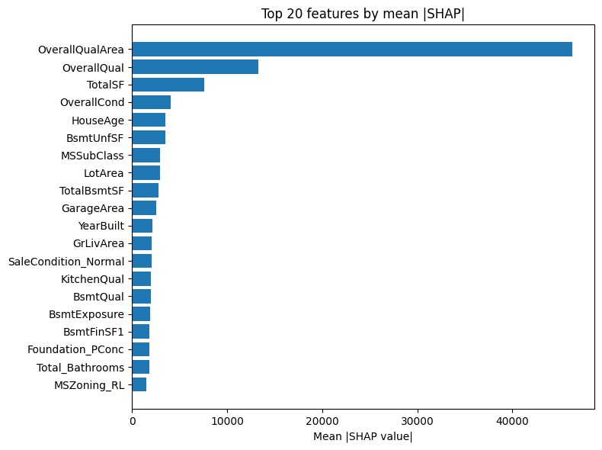
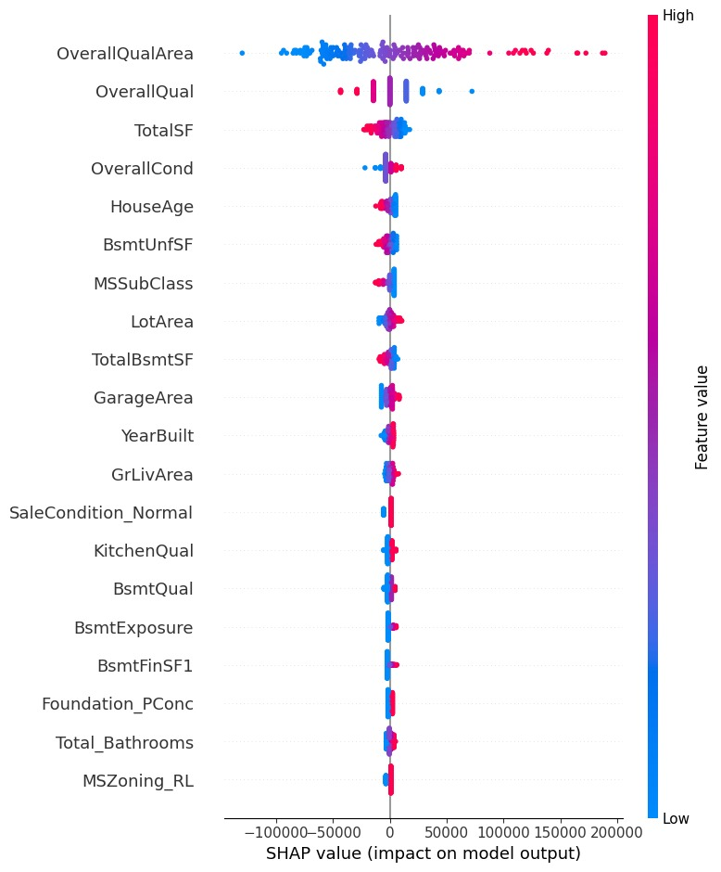

Model Explainability with SHAP
SHAP (SHapley Additive exPlanations) reveals which features drive model predictions
Top Influential Features
OverallQualArea: Quality-size interaction
OverallQual: Material and finish quality
TotalSF: Total square footage
GrLivArea: Above-ground living area
Feature Effect Patterns
The dot plot shows how feature values (color) impact predictions (horizontal position). Red (high values) push predictions higher, confirming real- estate intuition.
Key Insight:
SHAP analysis confirms that home quality and total living area are the biggest price drivers, and the model behaves consistently with real-estate domain knowledge

Slide 18


Kaggle Competition Results
Final Kaggle Score
0.13820
RMSE (Root Mean Square Error)
Model
Ridge Regression
Validation R²
0.9053
Best Alpha
10
Result:
Strong performance and excellent generalization on unseen test data, confirming the model's robustness and the effectiveness of the feature engineering and preprocessing pipeline.

Slide 19

Streamlit Deployment
Interactive web application for real-world house price predictions
Application Features
Technology Stack
Frontend: Streamlit with custom CSS styling
Model: Pickled Ridge Regression (alpha=10)
Processing: Pandas & NumPy for transformations
Explainability: SHAP for feature contributions
Deployment: Streamlit Cloud
→ Users input key home characteristics via clean UI
→ Model predicts sale price instantly
→ Optional SHAP visualizations for transparency
→ Pickled Ridge model loaded at app startup
Access the Application
Try the live demo and make your own house price predictions:
Why Streamlit?
Lightweight, Python-native framework enabling rapid deployment of ML models with interactive UIs. Perfect for showcasing real-world usability and model accessibility.
Launch Streamlit App →

Slide 20






Key Insights & Learnings
4. Regularization Prevents Overfitting
GridSearchCV identified alpha=10 as optimal, balancing model complexity with generalization. This prevented overfitting on training data while maintaining strong validation performance.
Differentiating structural absence from genuine missing values was critical. Filling "None" for non- existent features preserved real- estate logic and prevented model confusion.
5. Model Explainability Builds Trust
SHAP analysis confirmed model predictions align with real-estate intuition, making the model trustworthy for stakeholders and demonstrating that quality and size drive prices.
Domain-driven features like OverallQualArea and TotalSF captured complex interactions that raw features couldn't express, significantly improving model signal.
3. Ridge Excels on High-Dimensional Data
Ridge Regression handled one-hot encoded categorical features and multicollinearity exceptionally well, providing stable and interpretable results.
6. Deployment Completes the Pipeline
Streamlit deployment transformed the model from an experimental notebook into a practical tool, demonstrating real-world applicability and user accessibility.

Slide 21
Future Enhancements
Hyperparameter Refinement
Explore wider alpha range or adaptive regularization techniques to further reduce prediction error
External Data Integration
Incorporate neighborhood-level data (crime rates, school scores, accessibility) to strengthen price prediction signals
Deeper Error Analysis
Use advanced SHAP analysis to identify features causing consistent under/over-estimation patterns
Enhanced App UX
Improve Streamlit app by grouping features intuitively and adding optional "advanced inputs" for power users
Alternative Linear Models
Test ElasticNet with tuned L1/L2 balance to determine if sparsity improves generalization
Model Monitoring
Implement performance tracking in production to detect data drift and schedule model retraining

Slide 22

Thank You
Questions?

